Slide 1
Workshop 5
COMP90051 Statistical Machine Learning
Semester 2, 2022

Slide 2
Learning Outcomes
At the end of this workshop you should be able to:
be able to prove the validity of kernels, e.g. by applying Mercer’s theorem
be able to fit SVMs in scikit-learn using a grid search for the hyperparameters
develop intuition about how SVM decision surfaces are affected by hyperparameters

Slide 3
Worksheet 5a

Slide 4
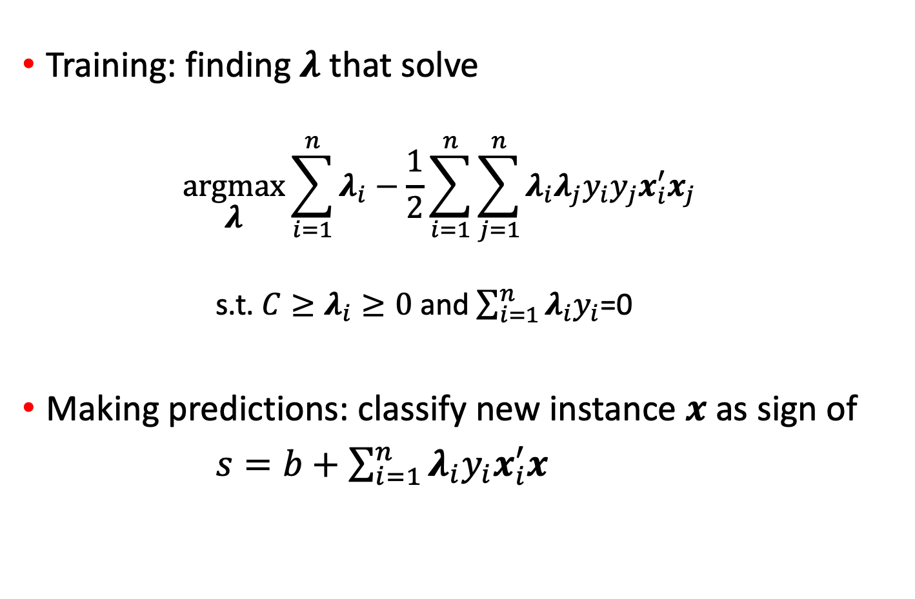
Soft-margin SVM’s dual formulation
Training: finding 𝝀 that solve
$$\underset{\text{λ}}{argmax}{\sum_{i=1}^{n}{{\text{λ}}_{i}−\frac{1}{2}\sum_{i=1}^{n}{\sum_{j=1}^{n}{{\text{λ}}_{i}{\text{λ}}_{j}y_{i}y_{j}x_{i}^{′}x_{j}}}}}$$
s.t. $C≥{\text{λ}}_{i}≥0$ and $\sum_{i=1}^{n}{{\text{λ}}_{i}y_{i}}$=0
Making predictions: classify new instance $x$ as sign of
$s=b+$ $\sum_{i=1}^{n}{{\text{λ}}_{i}y_{i}x_{i}^{′}x}$
Dot product
Dot product

Slide 5
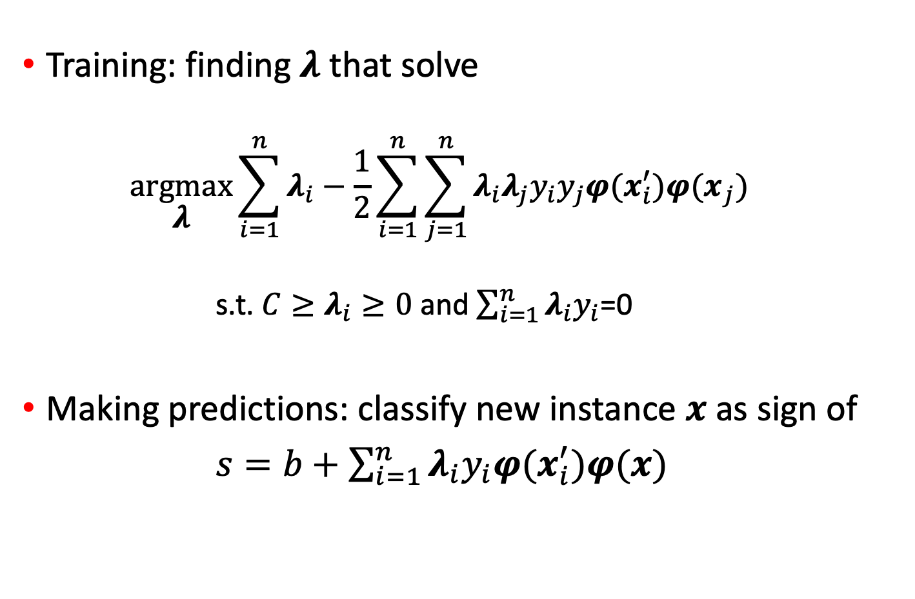
Soft-margin SVM’s in feature space
Training: finding 𝝀 that solve
$$\underset{\text{λ}}{argmax}{\sum_{i=1}^{n}{{\text{λ}}_{i}−\frac{1}{2}\sum_{i=1}^{n}{\sum_{j=1}^{n}{{\text{λ}}_{i}{\text{λ}}_{j}y_{i}y_{j}{φ(x}_{i}^{′}){φ(x}_{j})}}}}$$
s.t. $C≥{\text{λ}}_{i}≥0$ and $\sum_{i=1}^{n}{{\text{λ}}_{i}y_{i}}$=0
Making predictions: classify new instance $x$ as sign of
$s=b+$ $\sum_{i=1}^{n}{{\text{λ}}_{i}y_{i}{φ(x}_{i}^{′})φ(x)}$

Slide 6
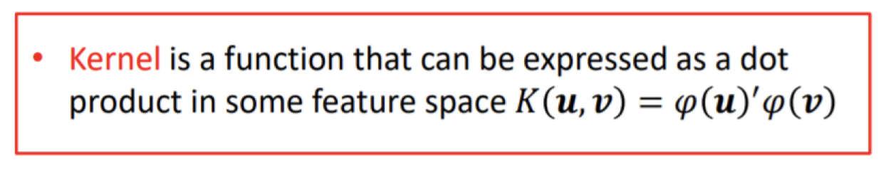
Kernel

Slide 7

Kernel soft-margin SVM
Training: finding 𝝀 that solve
$$\underset{\text{λ}}{argmax}{\sum_{i=1}^{n}{{\text{λ}}_{i}−\frac{1}{2}\sum_{i=1}^{n}{\sum_{j=1}^{n}{{\text{λ}}_{i}{\text{λ}}_{j}y_{i}y_{j}Κ(x_{i}x_{j}) }}}}$$
s.t. $C≥{\text{λ}}_{i}≥0$ and $\sum_{i=1}^{n}{{\text{λ}}_{i}y_{i}}$=0
Making predictions: classify new instance $x$ as sign of
$s=b+$ $\sum_{i=1}^{n}{{\text{λ}}_{i}y_{i}Κ(x_{i}x)}$
Feature mapping is implied by kernel
Feature mapping is implied by kernel

Slide 8
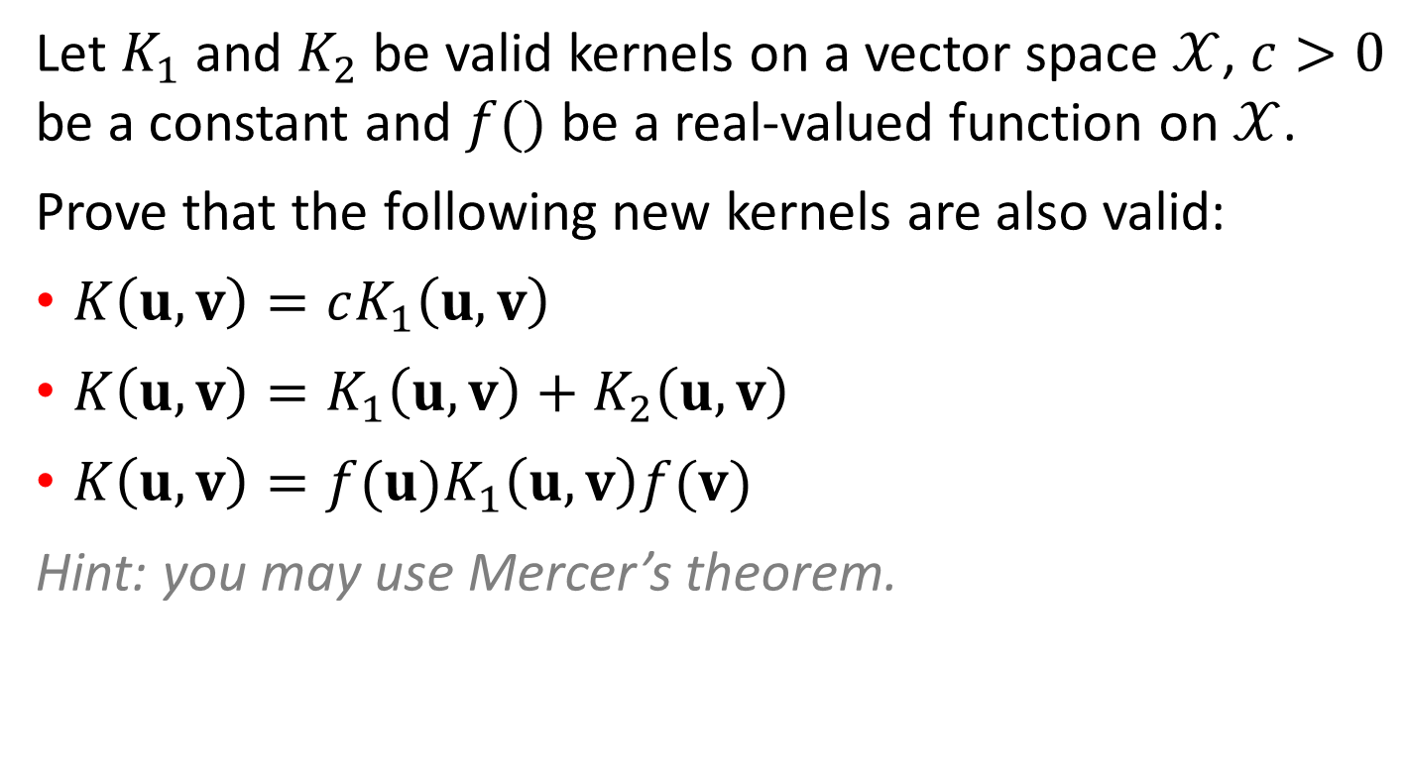
W5a: Kernel identities
Let $K_{1}$ and $K_{2}$ be valid kernels on a vector space $𝒳$, $c>0$ be a constant and $f()$ be a real-valued function on $𝒳$.
Prove that the following new kernels are also valid:
$K\left(u,v\right)=cK_{1}\left(u,v\right)$
$K\left(u,v\right)=K_{1}\left(u,v\right)+K_{2}\left(u,v\right)$
$K\left(u,v\right)=f(u)K_{1}\left(u,v\right)f(v)$
Hint: you may use Mercer’s theorem.

Slide 9
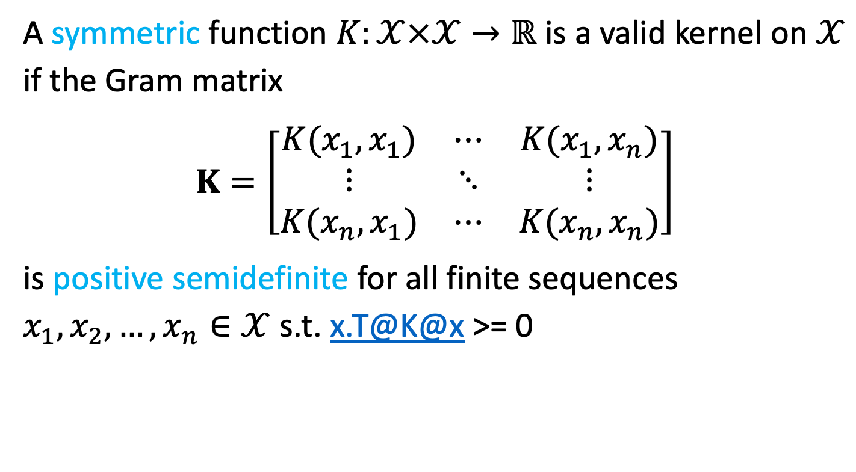
Mercer’s theorem
A symmetric function $K:𝒳×𝒳→ℝ$ is a valid kernel on $𝒳$ if the Gram matrix
$$K=\left[\begin{matrix}K(x_{1},x_{1}) & ⋯ & K(x_{1},x_{n}) \\ ⋮ & ⋱ & ⋮ \\ K(x_{n},x_{1}) & ⋯ & K(x_{n},x_{n})\end{matrix}\right]$$
is positive semidefinite for all finite sequences $x_{1},x_{2},…, x_{n}∈𝒳$ s.t. x.T@K@x >= 0

Slide 10
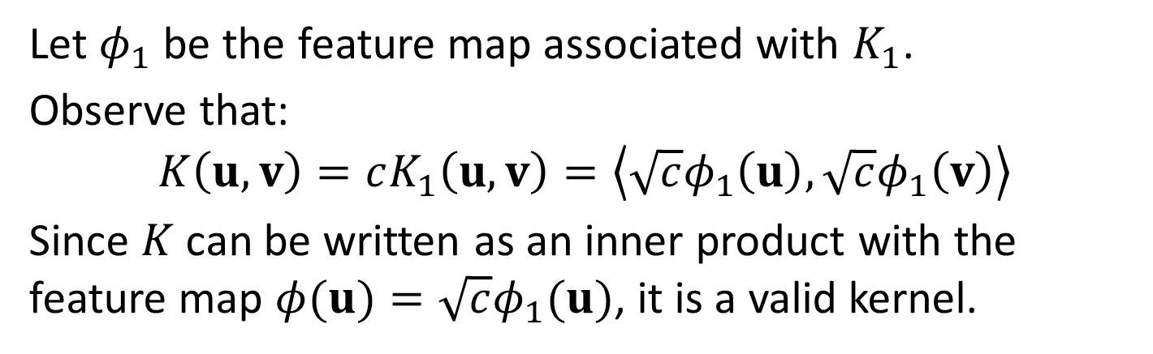
W5a: Kernel identities
Prove that $K\left(u,v\right)=cK_{1}\left(u,v\right)$ is a valid kernel
Let $φ_{1}$ be the feature map associated with $K_{1}$.
Observe that:
$$K\left(u,v\right)=cK_{1}\left(u,v\right)=\left\langle \sqrt{c}φ_{1}\left(u\right),\sqrt{c}φ_{1}\left(v\right)\right\rangle$$
Since $K$ can be written as an inner product with the feature map $φ(u)=\sqrt{c}φ_{1}(u)$, it is a valid kernel.

Slide 11
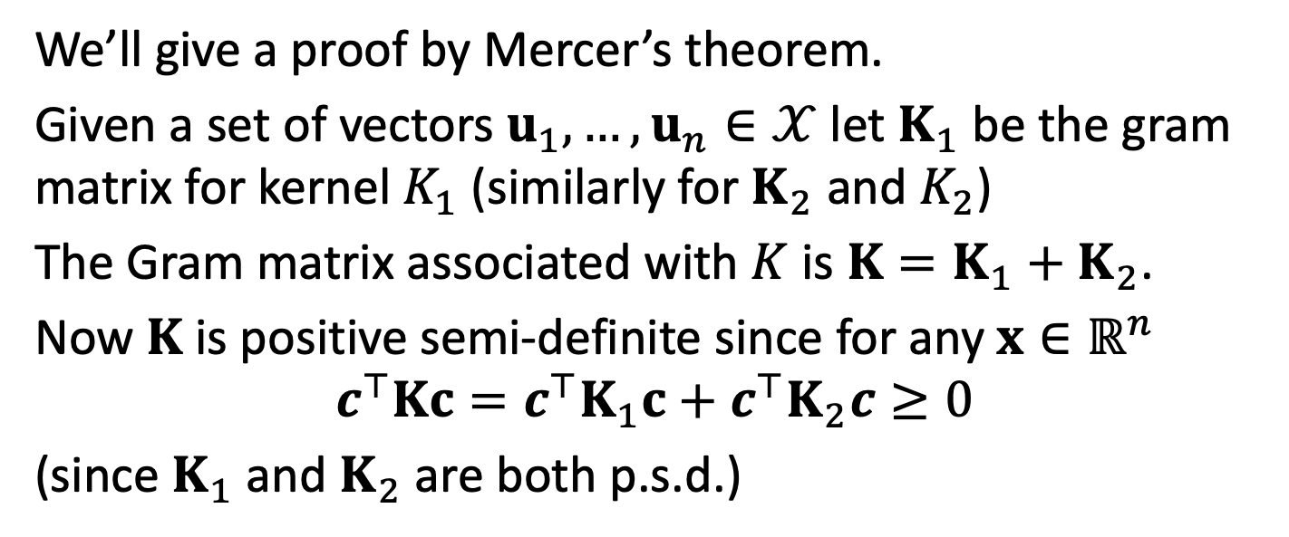
W5a: Kernel identities
Prove that $K\left(u,v\right)=K_{1}\left(u,v\right)+K_{2}\left(u,v\right)$ is a valid kernel
We’ll give a proof by Mercer’s theorem.
Given a set of vectors $u_{1},…,u_{n}∈𝒳$ let $K_{1}$ be the gram matrix for kernel $K_{1}$ (similarly for $K_{2}$ and $K_{2}$)
The Gram matrix associated with $K$ is $K=K_{1}+K_{2}$.
Now $K$ is positive semi-definite since for any $x∈ℝ^{n}$
$$c^{⊤}Kc=c^{⊤}K_{1}c+c^{⊤}K_{2}c≥0$$
(since $K_{1}$ and $K_{2}$ are both p.s.d.)

Slide 12
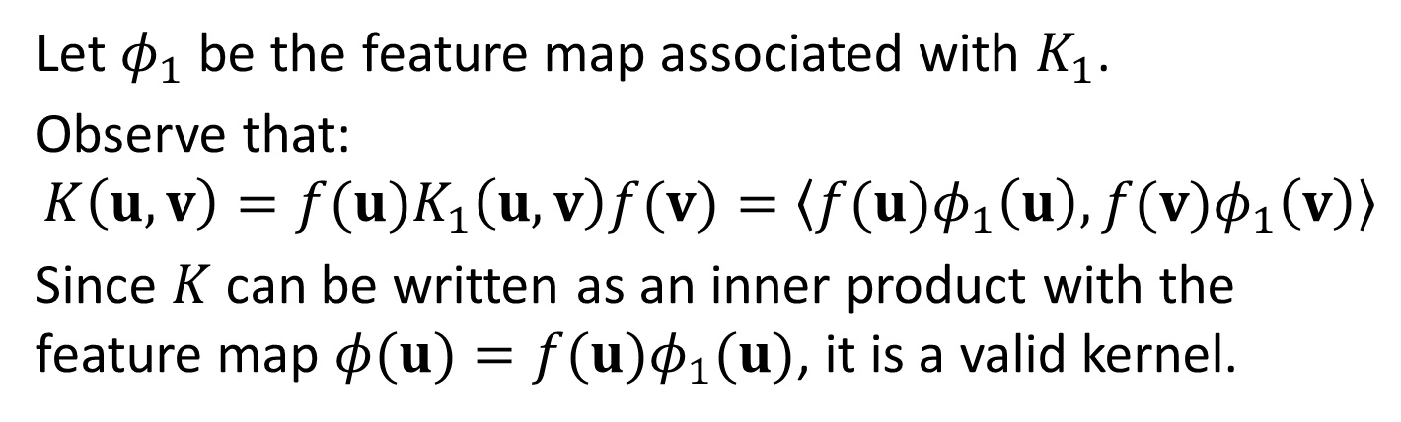
W5a: Kernel identities
Prove that $K\left(u,v\right)=f(u)K_{1}\left(u,v\right)f(v)$ is a valid kernel
Let $φ_{1}$ be the feature map associated with $K_{1}$.
Observe that:
$$K\left(u,v\right)=f(u)K_{1}\left(u,v\right)f(v)=\left\langle f(u)φ_{1}\left(u\right),f(v)φ_{1}\left(v\right)\right\rangle$$
Since $K$ can be written as an inner product with the feature map $φ(u)=f(u)φ_{1}(u)$, it is a valid kernel.

Slide 13
Worksheet 5b

